Slide 1
Tort Damages
Hon. Joan Zeldon (Ret.)
Crystal S. Deese, Esq.
Denis Mitchell, Esq.
Todd P. Kendrick, Esq.
Sponsored by the D.C. Bar November 5, 2020

Slide 2

Damages

Slide 3
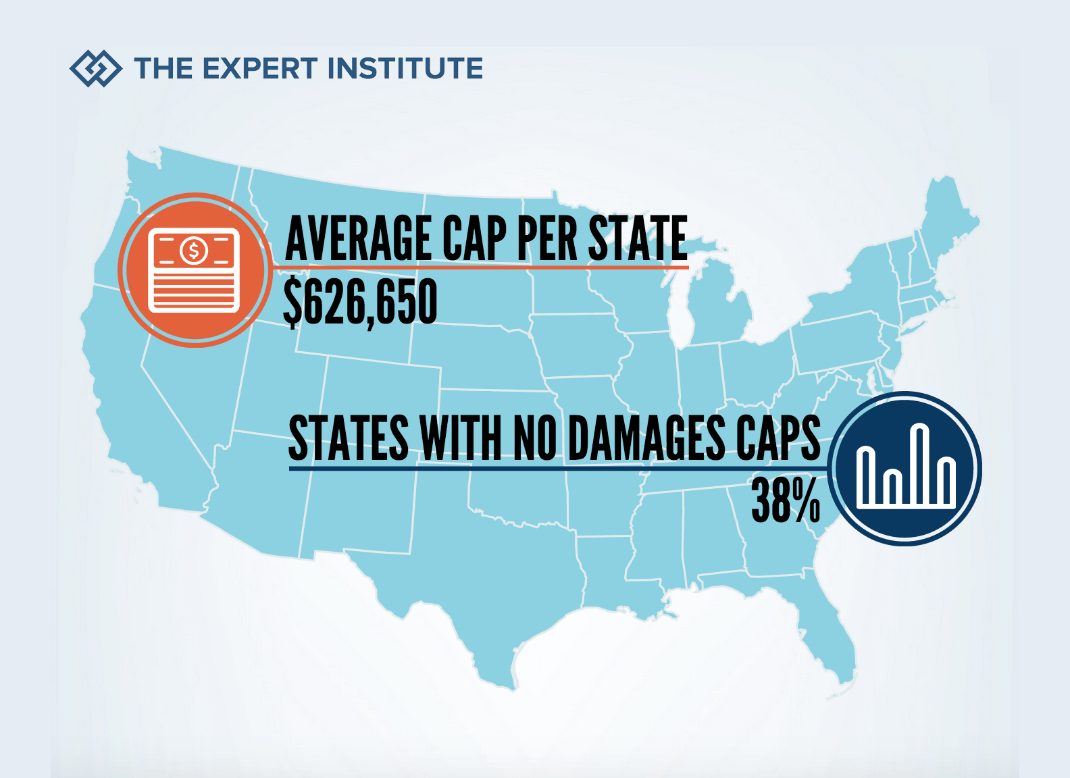
D.C. – NO caps

Slide 4

Damage Caps - Maryland
Maryland – Caps non-economic damages in personal injury & wrongful death cases (Md. Code, Cts. & Jud. Proc., 11-108); $875,000.00 as of Oct. 2020.
Maryland – Caps non-economic damages in medical malpractice cases (Md. Code, Cts. & Jud. Proc., 3-2A-09); $830,000.00 as of Oct. 2020.

Slide 5

Damage Caps - Virginia
Virginia – Caps medical malpractice awards (Va. Code § 8.01-581.15); $2.45M as of July 2020.
Virginia Caps punitive damage awards in medical malpractice cases (Va. Code § 8.01-38.1); $350,000.00; &
Virginia – does not cap personal injury damages outside of medical malpractice cases.

Slide 6

Certainty of Damages

Slide 7

TOO SPECULATIVE

Slide 8

It’s different for babies

Slide 9

Economist Required?

Slide 10

Medical Records

Slide 11

Clements v. United States, 669 A.2d 1271, 1273 (D.C. 1995).
Medical facts, routinely performed procedures, and Diagnosis about which competent physicians would agree.

Slide 12

Pathologically germane – Marlow v. Cerino, 313 A.2d 505 (Md. App. 1974).
`pathologically germane' statement `must fall within the broad range of facts which under hospital practice are considered relevant to the diagnosis or treatment of the patient's condition.‘
having significant bearing upon and relation to the disease or injury from which one suffers.”

Slide 13
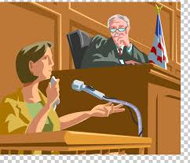
Neeley v. Johnson, 211 S.E.2d 100, 215 Va. 565 (1975).
If you want an opinion from medical records to be called to the jury's attention, you need to call the person who wrote the note as a witness at trial

Slide 14

Future Care Needs

Slide 15

Photograph admissibility

Slide 16
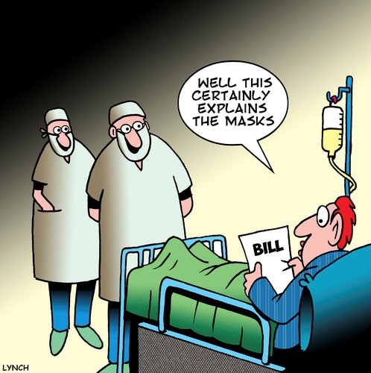
Medical bill admissibility

Slide 17
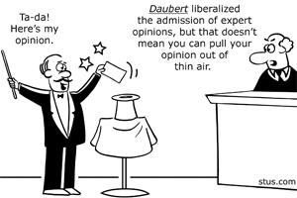
Motorola, Inc. v. Murray, 147 A.3d 751 (D.C. 2016)

Slide 18
Collateral Source Rule
Appellate and Trial Courts
"The collateral source rule provides, as a general proposition, that a party may recover full compensatory damages from a tortfeasor regardless of the payment of any amount by any independent party (a 'collateral source'), such as an insurance carrier."
Hardi v. Mezzanotte, 818 A.2d 974 (D.C. 2003).
Hudson v. Lazarus, 217 F.2d 344, 95 U.S. App. D.C. 16 (D.C. Cir. 1954).
Albano v. Yee, 219 A.2d 567 (D.C. 1967).
Bushong v. Park, 837 A.2d 49 (2003).
Shell v. Rock Creek Nursing Center, Inc., 2014 WL 926261 (D.C. Super. Jan. 3, 2014).

Slide 19

Arguing Damages to the Jury

Slide 20

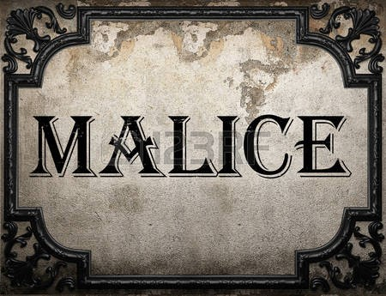

Punitive damages

Slide 21
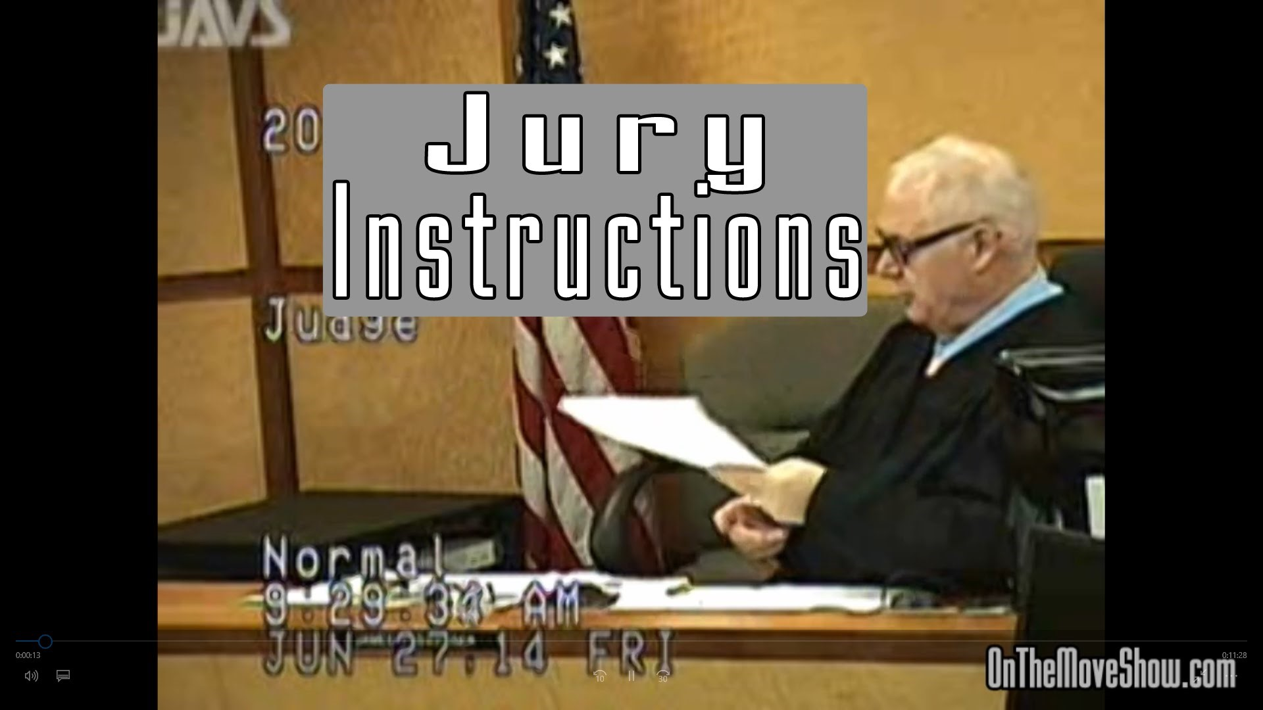

Slide 22

Remittiturs

Slide 23


Questions???

